Slide 1
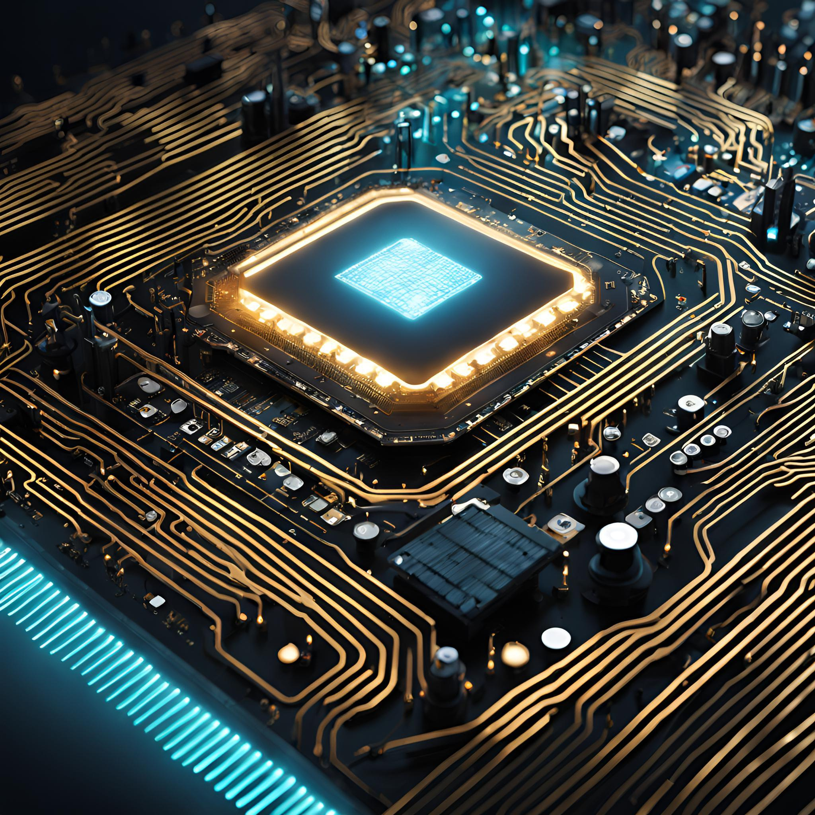


ELEVATOR CONTROLLER PROJECT
BECHARA RAAD CARLOS ABOU SAWAN

Slide 2
TABLE OF CONTENT
03
04
05
06
INTRODUCTION
FIRMWARE ARCHITECTURE
BLOCK DIAGRAM
FLOWCHART
07
08
CHALLENGES AND SOLUTIONS
CONCLUSION AND FUTURE EXPANSIONS
02

Slide 3

INTRODUCTION
Purpose: Why is the project important?
Elevators are essential for modern infrastructure.
Aimed to develop a microcontroller-based system ensuring functionality, safety, and convenience.
Key Features:
Floor-specific control mechanisms.
Displaying time, date, and temperature in the cabin.
Efficient motor control.
03

Slide 4
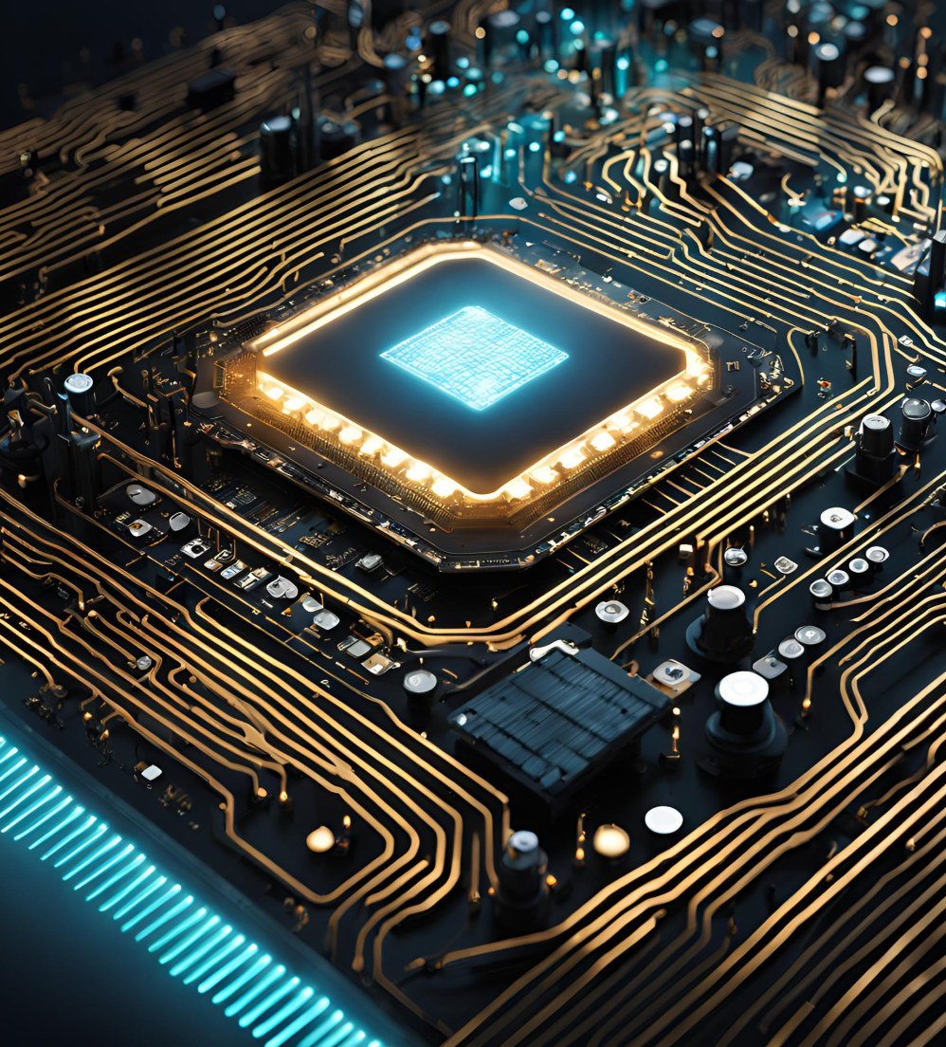
FIRMWARE ARCHITECTURE
Task Scheduler: Manages periodic and asynchronous tasks.
RTC Integration: I2C communication for accurate time and date.
Temperature Monitoring: LM35 sensor for temperature readings.
Motor Control: Two-speed operation and dual-direction.
Display Management: GPIO operations for floor indicators, BCD control for 7-segment displays.
04

Slide 5
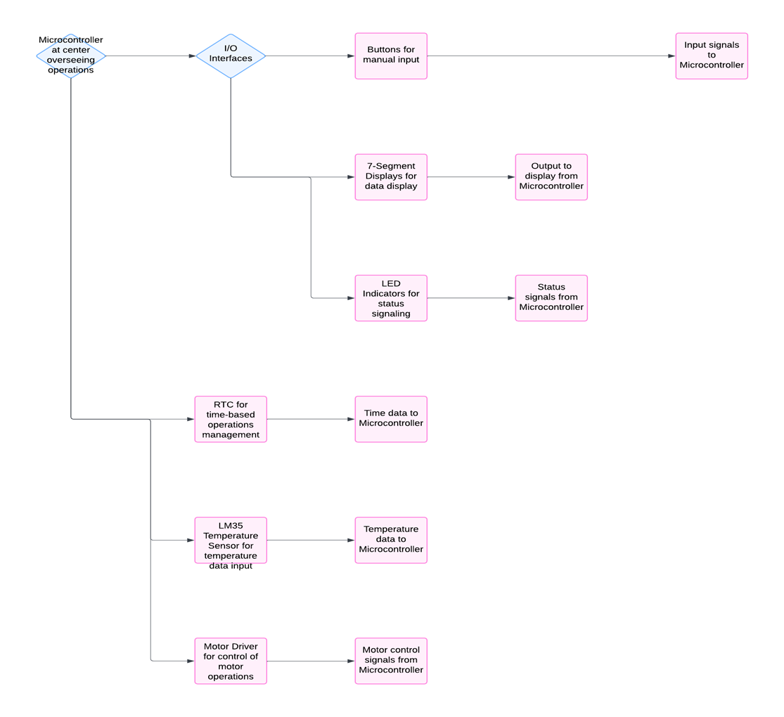
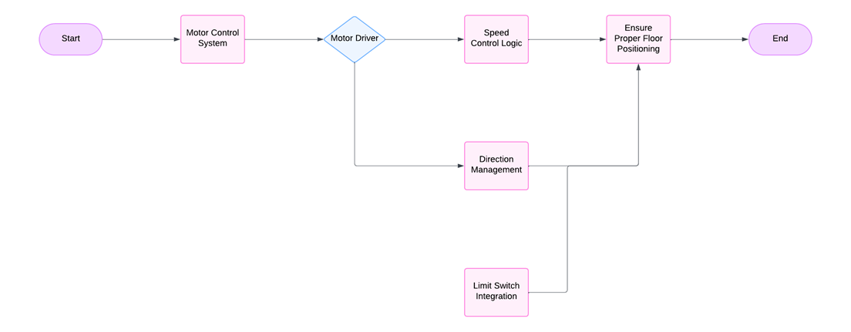
BLOCK DIAGRAMS
System Architecture Diagram:
Motor control system diagram:
05

Slide 6
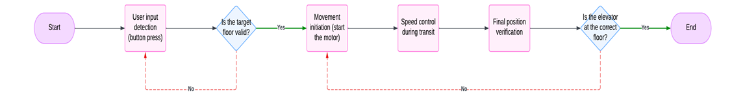
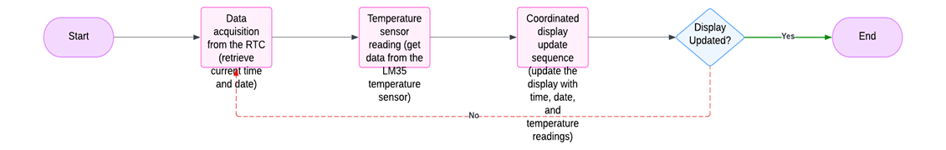
FLOWCHARTS
Floor Request Handling Flowchart:
Display Update Logic Flowchart:
06

Slide 7


CHALLENGES AND SOLUTIONS
PROBLEM
SOLUTION
The elevator may move too fast or too slow, causing inconsistent arrival at the desired floor.
Adjust the motor control logic to ensure consistent speed by fine-tuning the initial speed or acceleration.
07

Slide 8
CONCLUSION AND FUTURE EXPANSIONS
This project demonstrates the integration of hardware and software for reliable elevator control.
FUTURE ENHANCEMENTS:
VARIABLE SPEED CONTROL AND OPTIMIZED ACCELERATION.
SAFETY FEATURES LIKE EMERGENCY BRAKES AND DOOR CONTROLS.
WIRELESS MONITORING AND ADDITIONAL FLOOR SUPPORT.
08

Slide 9
THANK YOU

